Slide 1
CrazyFlasher4(闪客快打4)
卞证 Bian Zheng

Slide 2
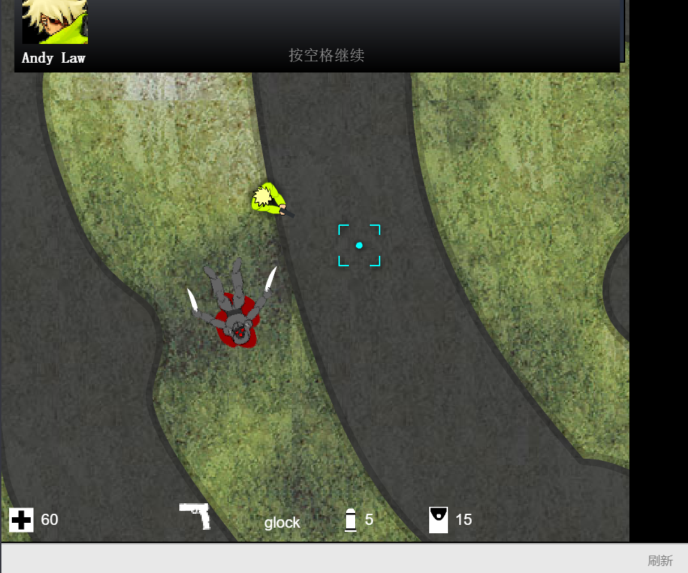
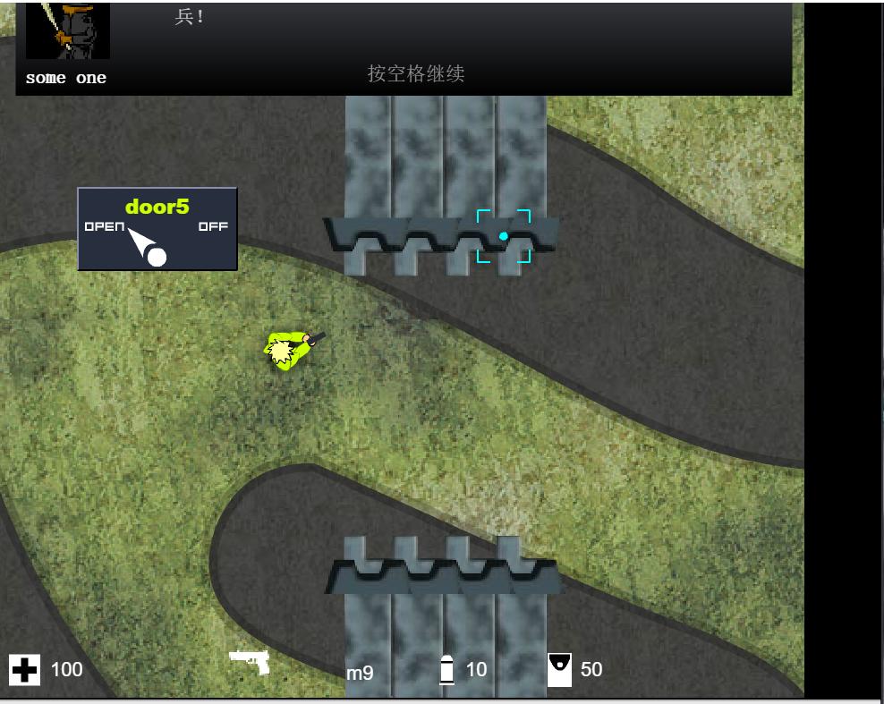
Description

Slide 3
Reasons
Exciting music
Strong sense of attack
Excellent production
Various props(道具多样)
Recoil force(具有后坐力)

Slide 4
Strength
Coding
Have made 2D games using Unity3D
The model of the demo is made on the internet
Logic is made by myself
The experience of making a game will be benefit to this 2D project

Slide 5
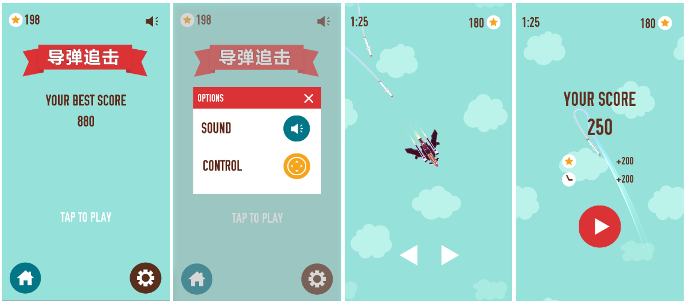
The snap of game project

Slide 6
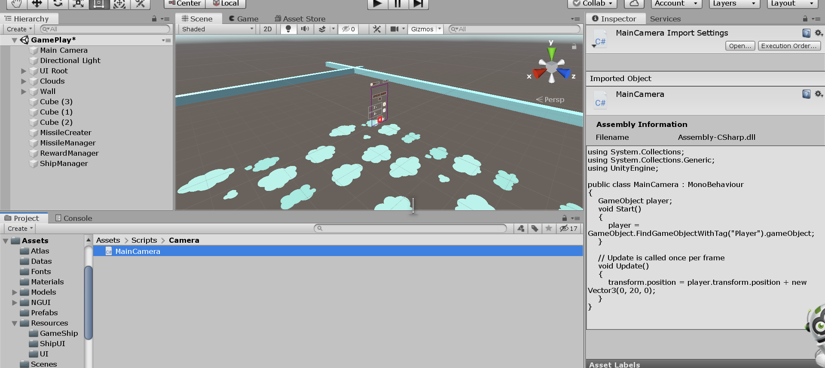
Unity Project on my laptop

